Slide 1
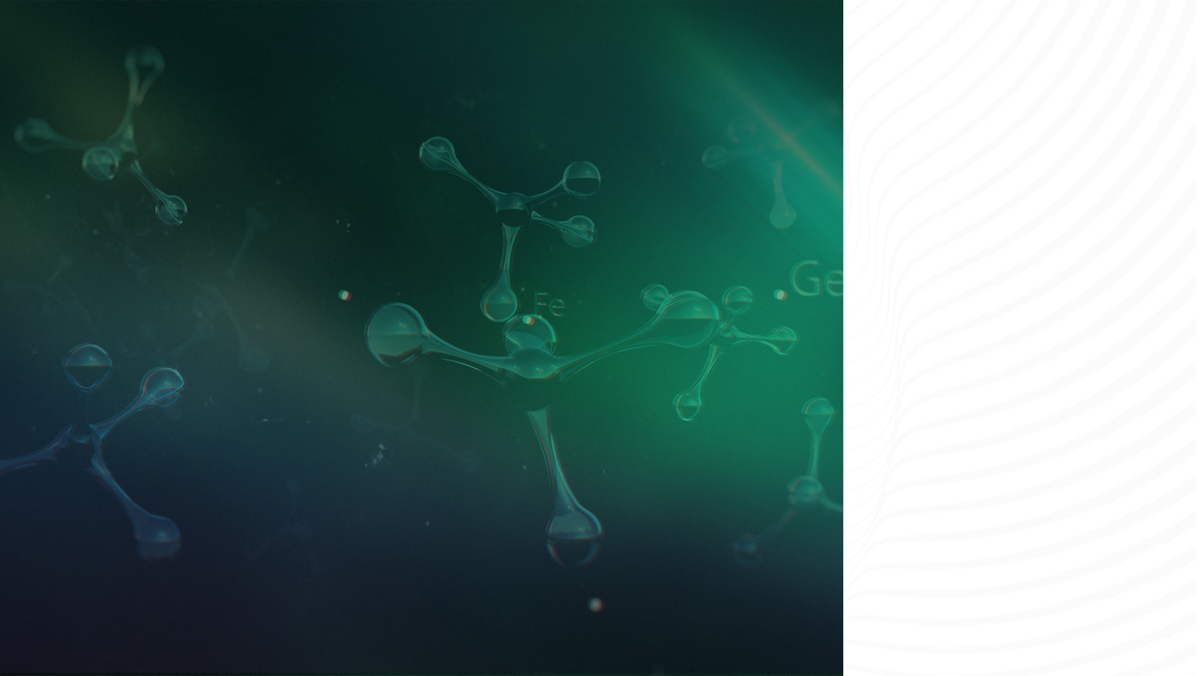

ScNET A Model That Combines PPI and Gene Expression
© ThinkBio.Ai All Right Reserved

Slide 2
Agenda
Single Cell Data Challenges And Solutions
ScNET –Overview And Architecture
ScNET Results

Slide 3
Single Cell Analysis And PPI Solutions
1.1 What's Single Cell data
  adata.x raw biological measurement.
 | CD3D | CD4 | CD8A | MS4A1 | LYZ
Cell_1 | 5 | 8 | 0 | 0 | 5
Cell_2 | 6 | 0 | 10 | 0 | 9
Cell_3 | 0 | 0 | 0 | 12 | 0
Cell_4 | 2 | 0 | 1 | 0 | 37
gene_name | highly_variable
CD3D | True
CD4 | True
CD8A | True
MS4A1 | True
LYZ | True
cell_id | cell_type | n_genes | n_counts
Cell_1 | CD4 T cell | 3 | 18
Cell_2 | CD8 T cell | 4 | 25
Cell_3 | B cell | 2 | 12
Cell_4 | Monocyte | 5 | 40
  adata.var helps us select and interpret genes.
adata.obs helps us interpret and label cells.

Slide 4
1.2. Challenges in the single cell data​
Gene / Cell | Cell_1 | Cell_2 | Cell_3 | Cell_4 | Cell_5 | Cell_6
Gene_A | 0 | 3 | 0 | 0 | 1 | 0
Gene_B | 0 | 0 | 0 | 2 | 0 | 0
Gene_C | 5 | 0 | 4 | 0 | 0 | 6
Gene_D | 0 | 0 | 0 | 0 | 0 | 1
Gene_E | 2 | 0 | 0 | 1 | 0 | 0
60–95% of the matrix entries can be zero – zero inflation.
Two sources – Biological zeros (aka Real Signal )and Technical Zeros(Dropouts)
Zero inflation nature
Complexes and
pathway activation
struggles to delineate

Slide 5
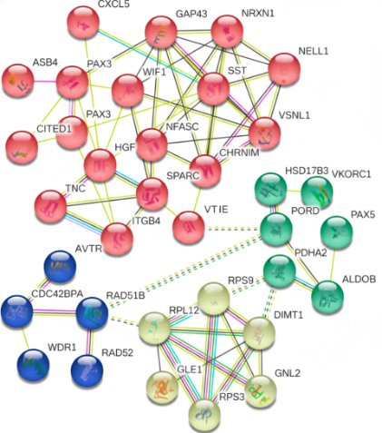
1.3 .Existing techniques to resolve Zero Inflation
ScRNA-seq
data imputation
Methods focus on the
numerical recovery
Correlation based
PPI network Based
zero inflated probabilistic models
nearest neighbour-based smoothening
dense latent representations
considers sequence depth and read errors
Pathway activation - Protein Complex activation - Signal Transduction.
Construction at global scale.
contextual information from PPI + Strong functional annotation from ScRNA-seq
Studies in PPI integration
  PPI-based propagation
  NSCLC survival models
  scRNA-seq enhancement.
  ScLINE
  PINNACLE
  scNET

Slide 6
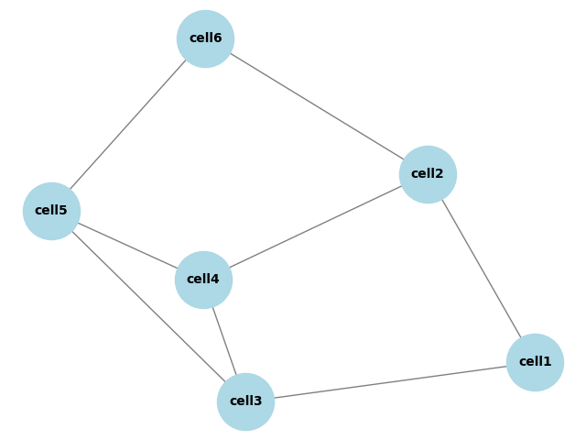
2. ScNET –Overview And Architecture
adata
scNET
adata
scNET
Reconstructed adata
Reconstructed adata

Slide 7
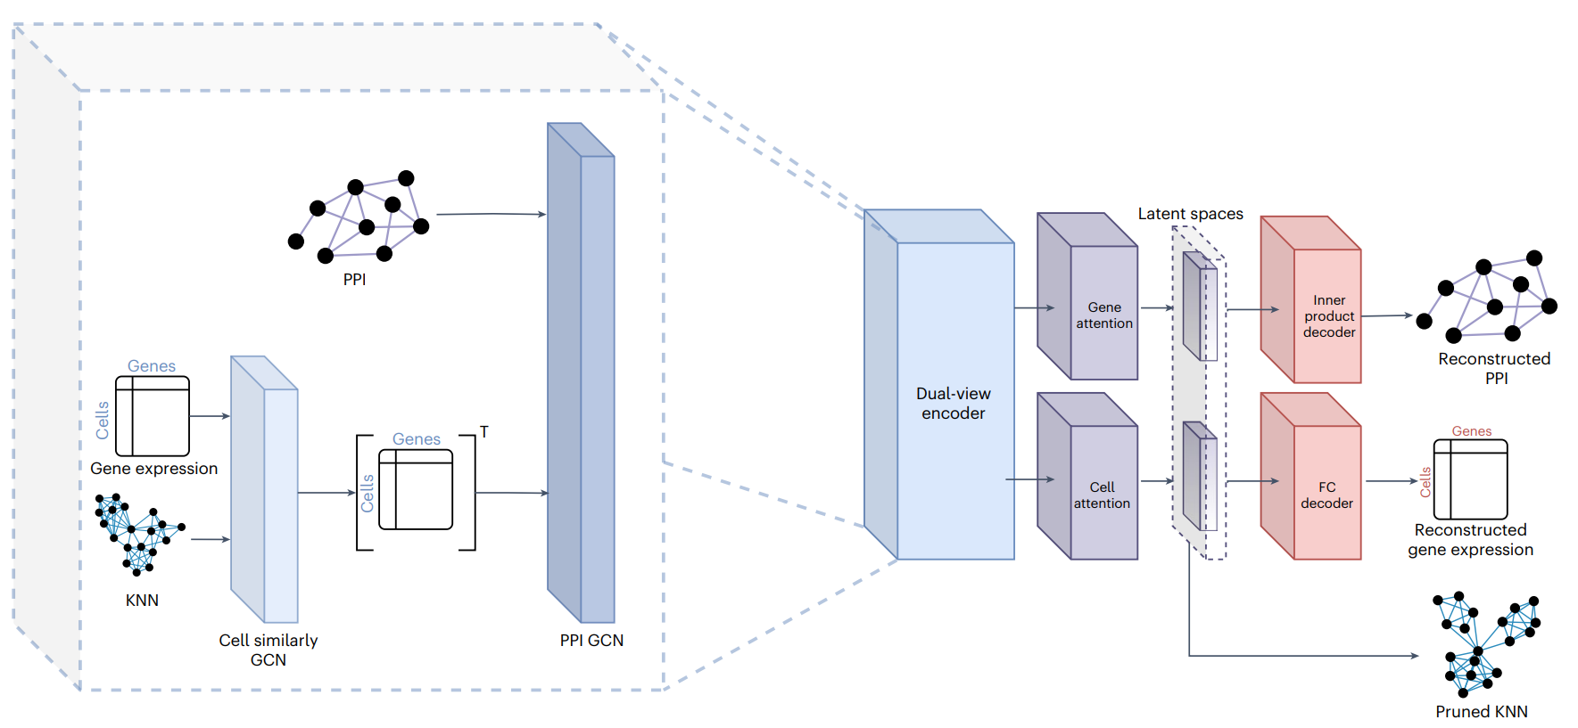
ScNET Auto Encoder Architecture

Slide 8

3. ScNET RESULTS
Gene Embeddings Improve
Functional Annotations
Co-embedded Network and Pathways
Cell clustering Evaluation
Reducing Zero Inflation
and Pathway Analysis

Slide 9
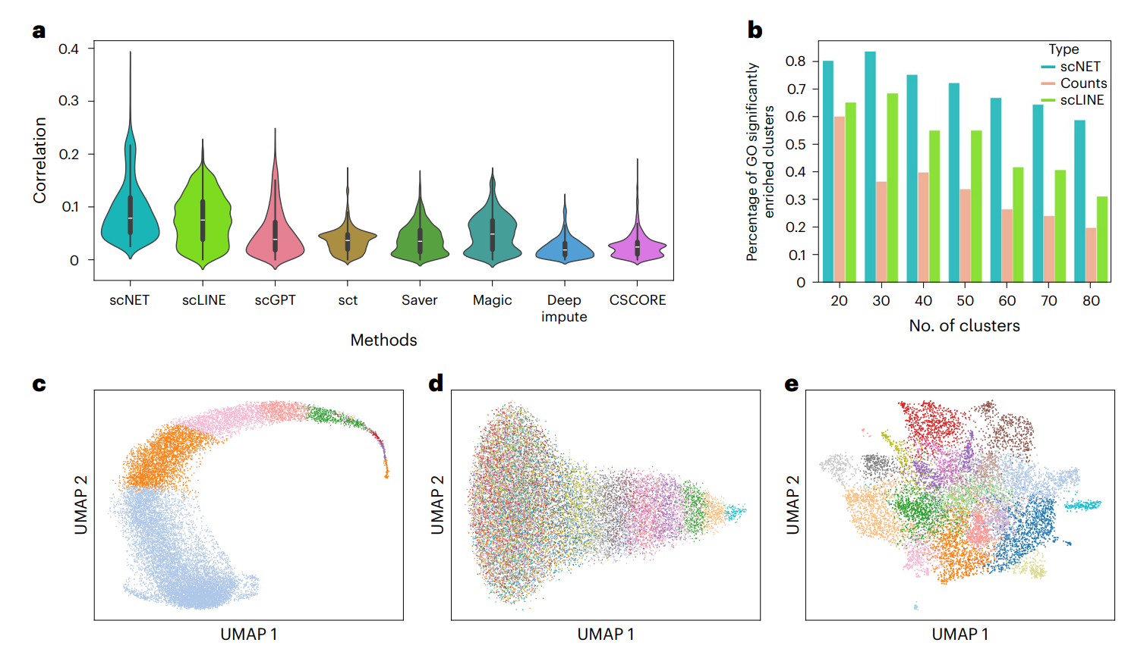
  Gene Embeddings Improve Functional Annotations
Gene Ontology (GO) semantic similarity value
Co-embedded coefficient.
GO (Gene Ontology) terms
Gene set enrichment analysis
counts
scLINE
scNET

Slide 10
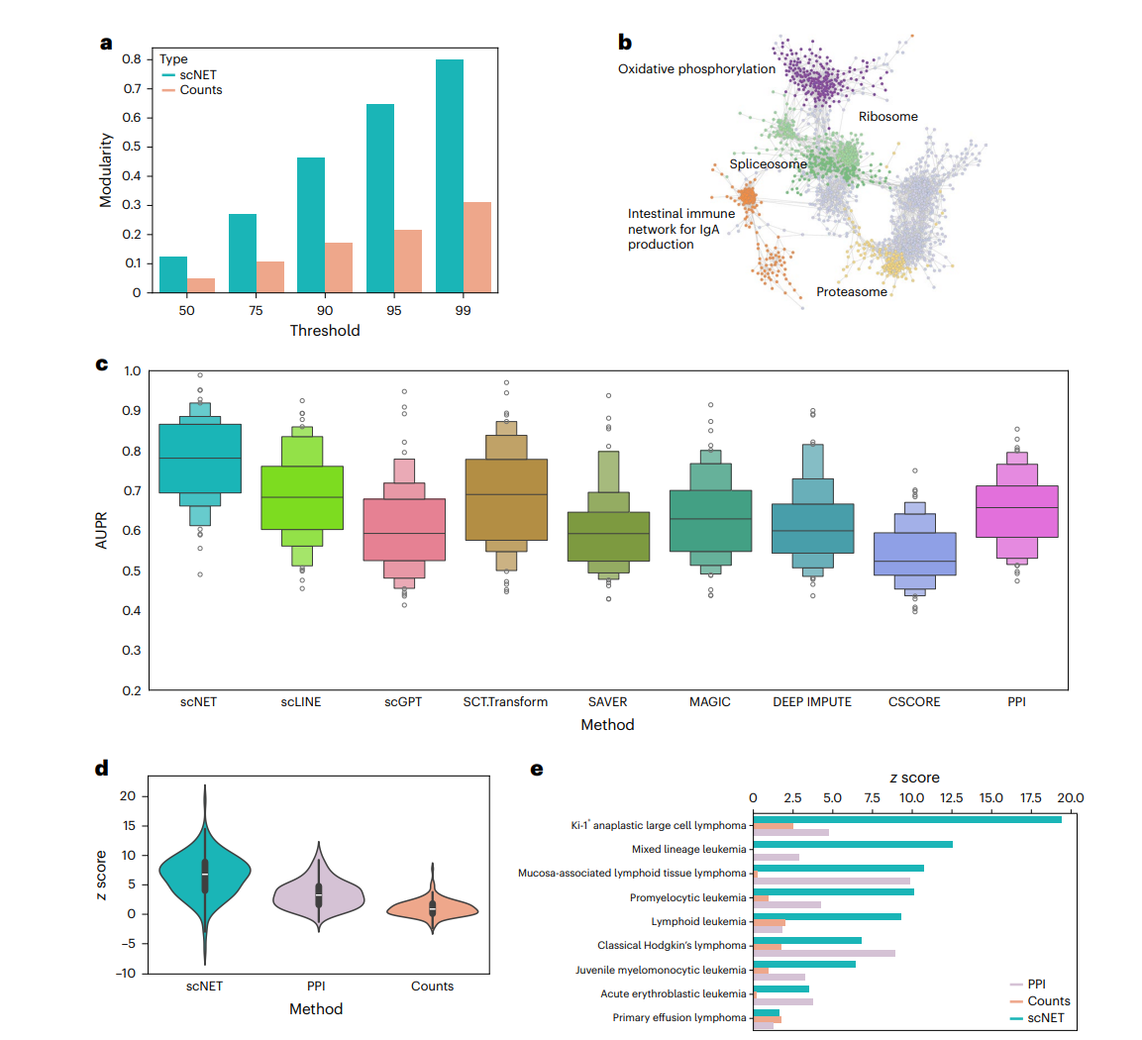
  Co-embedded Network And Pathways
Co-embedded Network
Modularity values of network
~0 → random-like network
0.3–0.6 → strong community structure
Term | What it means
Oxidative phosphorylation | Energy production in mitochondria
Ribosome | Protein synthesis machinery
Spliceosome | RNA splicing (processing mRNA)
Proteasome | Protein degradation and recycling

Slide 11
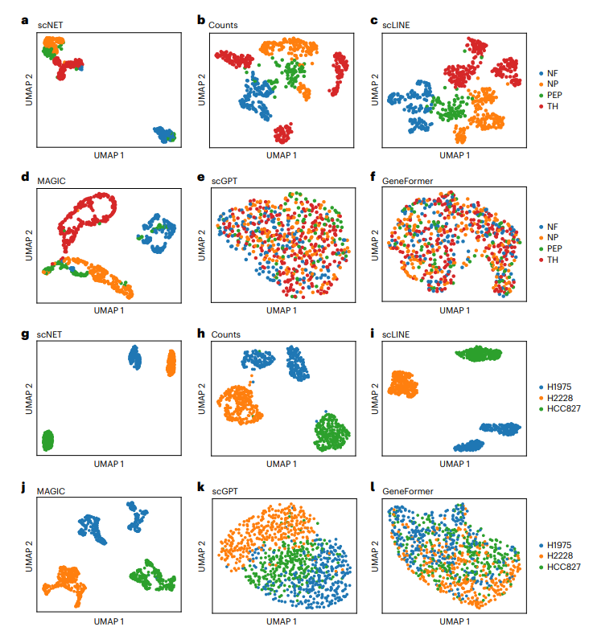
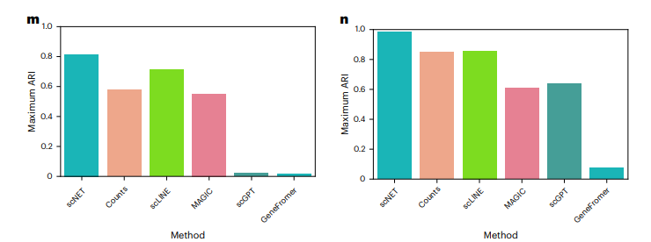
  Cell clustering Evaluation
Dorsal root ganglia (DRG)
Type | Main Function | Sensation
NF | Touch & proprioception | Non-painful touch
NP | Mechanical pain & itch | Pain
PEP | Thermal & inflammatory pain | Pain
TH | Pleasant touch | Gentle touch

Slide 12
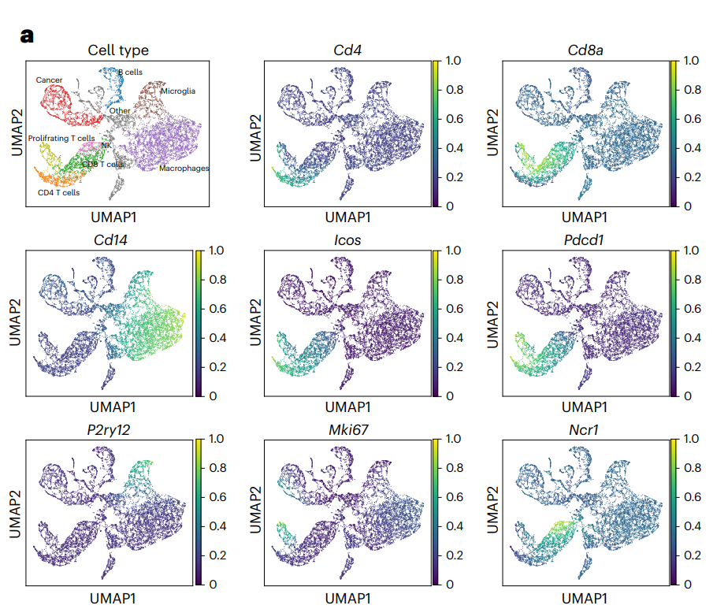
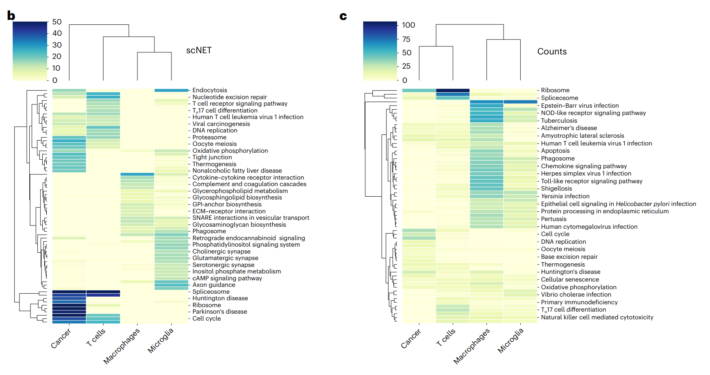
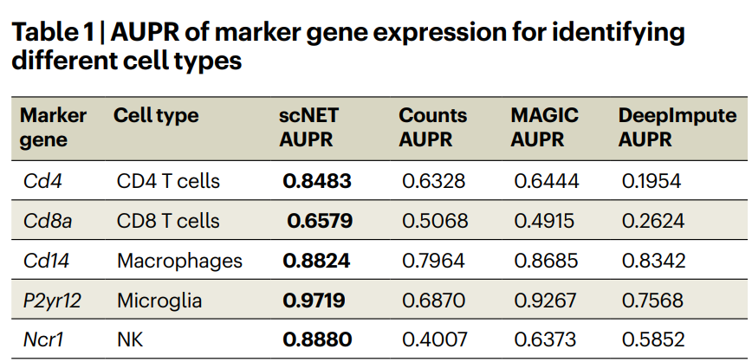
  scNET reduces zero inflation and improve pathway analysis

Slide 13

Thank You
3020 Old Ranch Pkwy.
Suite 300, Seal Beach, CA 90740
3602 Inland Empire Blvd., Suite C200,
Ontario, CA 91764, United States
611 Gateway Blvd, Suite 120,
South San Francisco, CA 94080
Info Park Phase-II,
Kakkanad, Kochi, India
Yamuna, Technopark Phase III
Trivandrum, India
34-35 Hatton Garden, Holborn,
London EC1N 8DX
contactus@thinkbio.ai
+1- 909-303-3338

